Slide 1

Salary Prediction
By Ms.Ulviyya Ismayilzada

Slide 2

Our target
In this project we are focused on predicting the salaries of data professionals by diving into the world of regression problem, analyzing data, feature engineering, modeling and developing model for getting well-performed model.

Slide 3


EDA:
Within Exploratory Data Analysis we unveiled valuable insights about data professionals' salaries. For this we involved data visualization, summary,statistics, and identifying patterns in the data.

Slide 4
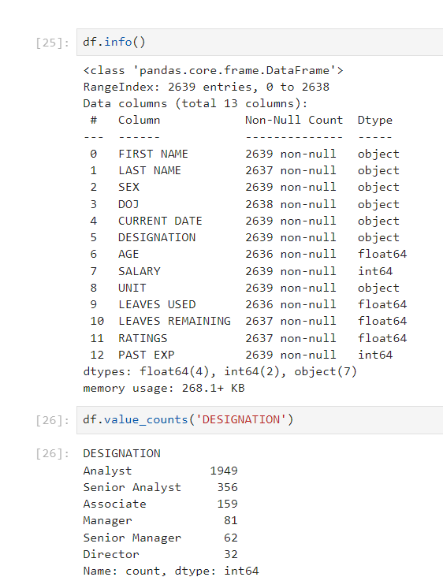
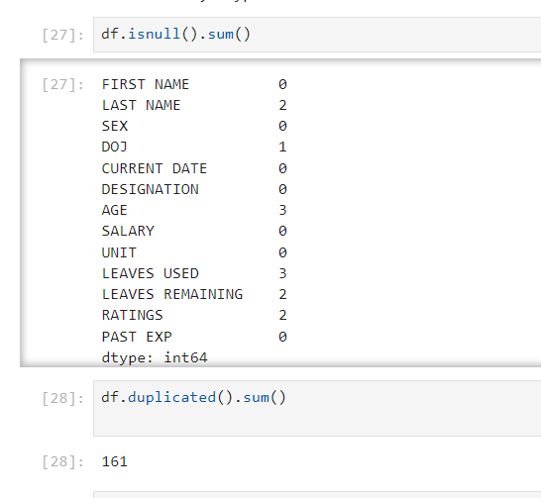
EDA: Our dataset contains 2639 rows × 13 columns. Data types of data are object, float and integers. Totally in the dataset there was 161 duplicated data and removed them. Additionally, there was 12 missing value. Due to our target is to give salary prediction for data professionals checking value counts of designation can be good insight

Slide 5
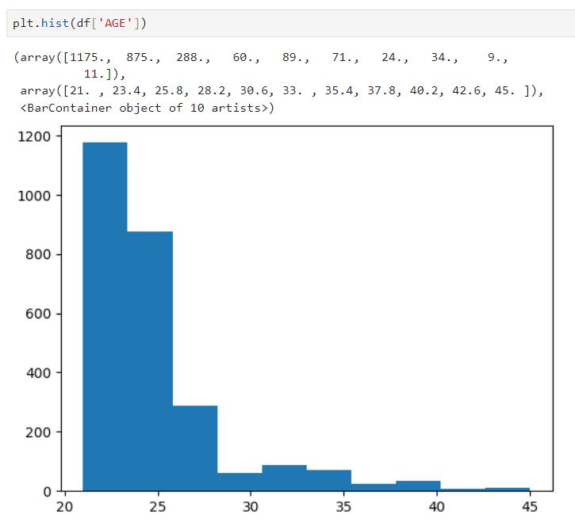
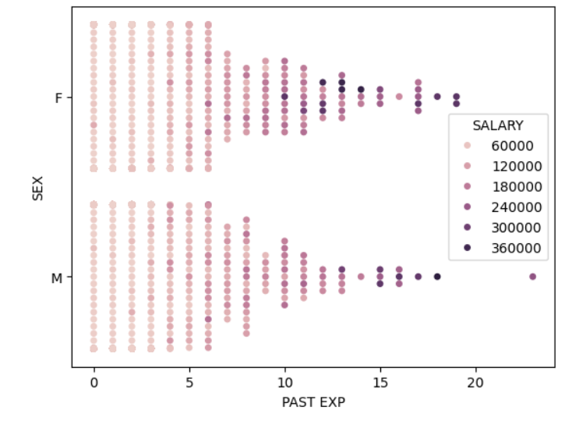
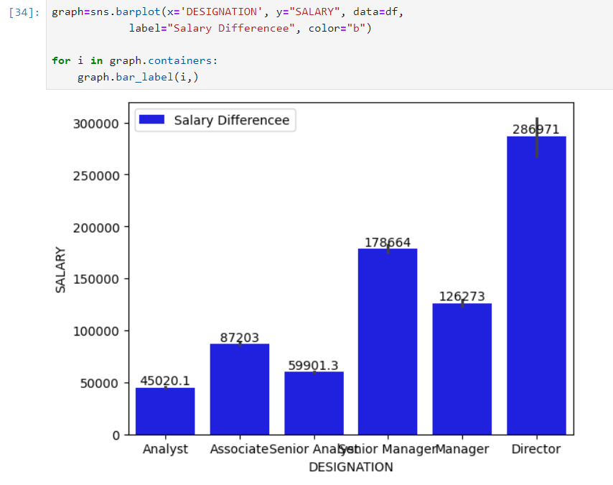
EDA: Age distribution demonstrate that main age group of data professionals is over 20 and below 30. Additionally, by visualize correlation between features such as salary and designation, experience, salary and sex we can find that experience plays crucial role in salary

Slide 6

Feature Engineering:
In our dataset, there is a feature as ‘date of joining the company’. However, this feature alone cannot provide special insights. By using this feature, we can calculate the experience in the company and add this value to the result of past work experience. This will give us the total experience of the workers, which will be a strong feature for predicting salary. Furthermore, some features, such as ID, are deleted at this stage.

Slide 7
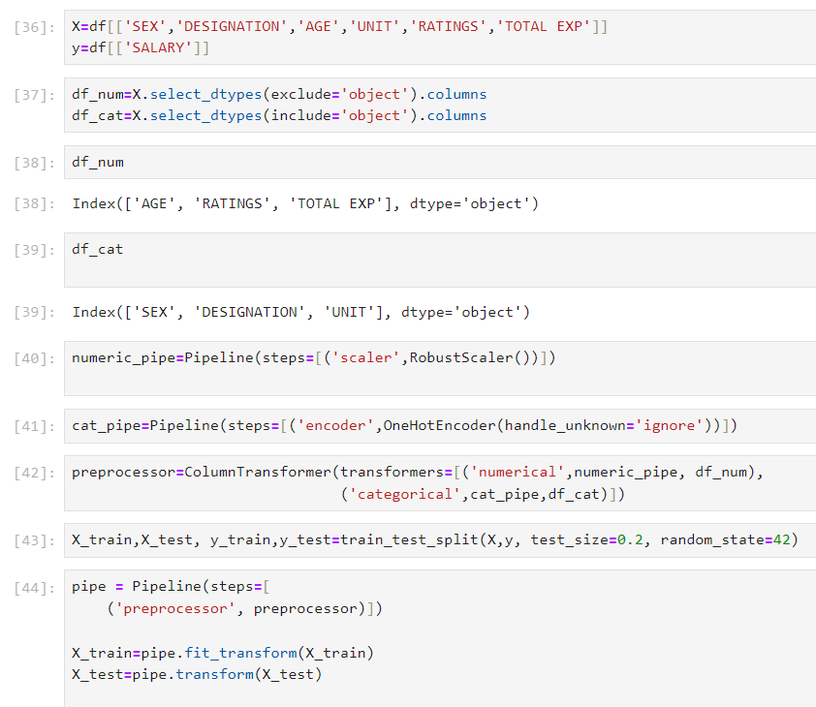
Data Preprocessing:
In this stage we prepare our data for model training. This includes handling missing values, encoding categorical variables, and scaling or normalizing features as needed.
Firstly, due to amount of our missing values is lower comparison with shape of dataset we can remove them without handling. Additionally, for this stage we have used pipeline for handling scaling and encoding.

Slide 8
Machine Learning Model Development:
As we know, we needed to predict continuous data, which means we would need regression models. Firstly, we used a train-test split for dividing the dataset. Additionally, we experimented with different algorithms such as Linear Regression, Decision Trees, Random Forests, and Gradient Boosting. To avoid overfitting, cross-validation was used for all models. Furthermore, GridSearchCV was implemented for hyperparameter tuning to find the best parameters.

Slide 9

Model Evaluation:
Mentioned models were evaluated by using evaluation metrics such as Mean Absolute Error (MAE), Mean Squared Error (MSE), Root Mean Squared Error (RMSE), Mean Absolute Percentage Error and R-squared (R2) score.
Mean Absolute Error (MAE): The average of the absolute differences between predicted and actual values.
Mean Squared Error (MSE): The average of the squared differences between predicted and actual values.
Root Mean Squared Error (RMSE): The square root of the average of the squared differences between predicted and actual values.
Mean Absolute Percentage Error (MAPE): The average of the absolute percentage differences between predicted and actual values.
R-squared (R²) Score: A statistical measure of how well the regression predictions approximate the real data points. Values range from 0 to 1, with 1 indicating perfect prediction.

Slide 10
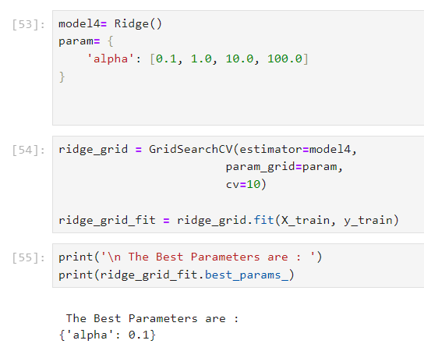
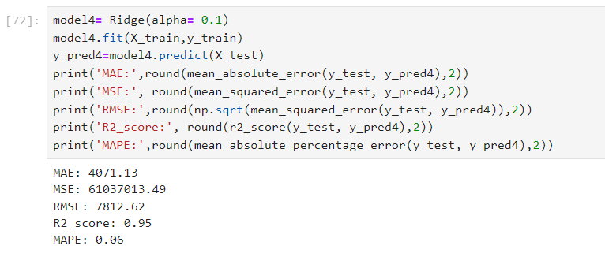
Ridge Regression model got below mentioned metrics
Here implemented Grid Search CV for hyper tuning parameter of Ridge. After defining best alpha rate for model, model experimented with it. Got 95% R2 score , and 0.06 Mean Absolute percentage error which means model performs well

Slide 11
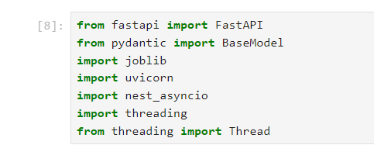
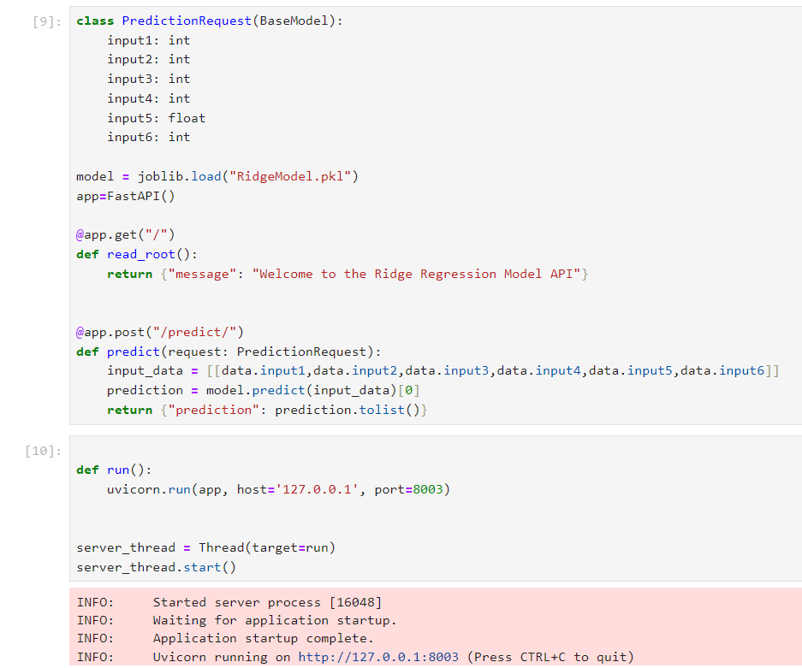
Model Deployment:
In this stage the model which had better result on evaluation metrics than other models are saved and deployed by using FASTAPI.

Slide 12

Conclusion:
Generally, the analysis of the dataset demonstrated that there are valuable features in our dataset, but for more accurate predictions, we will need additional features. It would be beneficial to gather some new features. Additionally, the better-performing models were Linear Regression, Ridge Regression, and Random Forest Regressor.
Due to the added cross-validation of modeling, we ensured that there is no overfitting, and adding new unseen data to the model cannot significantly affect the model’s results. The parameters of the Ridge Regression were optimized using Grid Search, which improved performance. The better resulted model were saved and deployed.

